Slide 1
SWORD BROS POSTMORTEM: Making a small physics sword fighting game
Drew Wallace (@_drew_wallace)
Designer/Programmer
Philly Game Mechanics 12/7/17

Slide 3
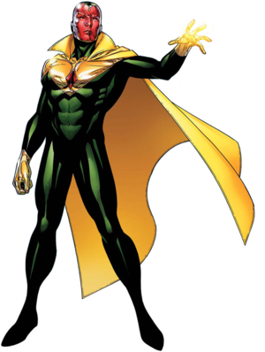
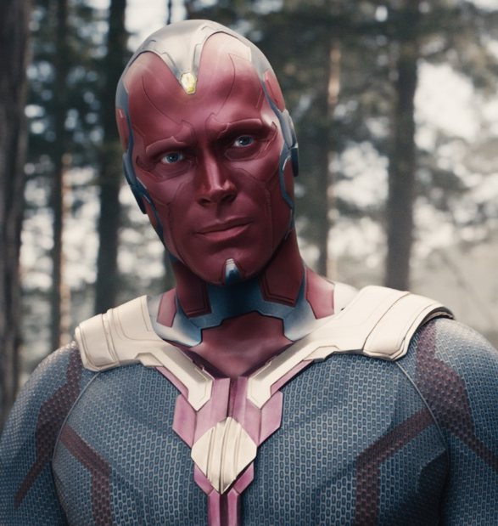
the vision: “physics-based sword fighting”

Slide 4
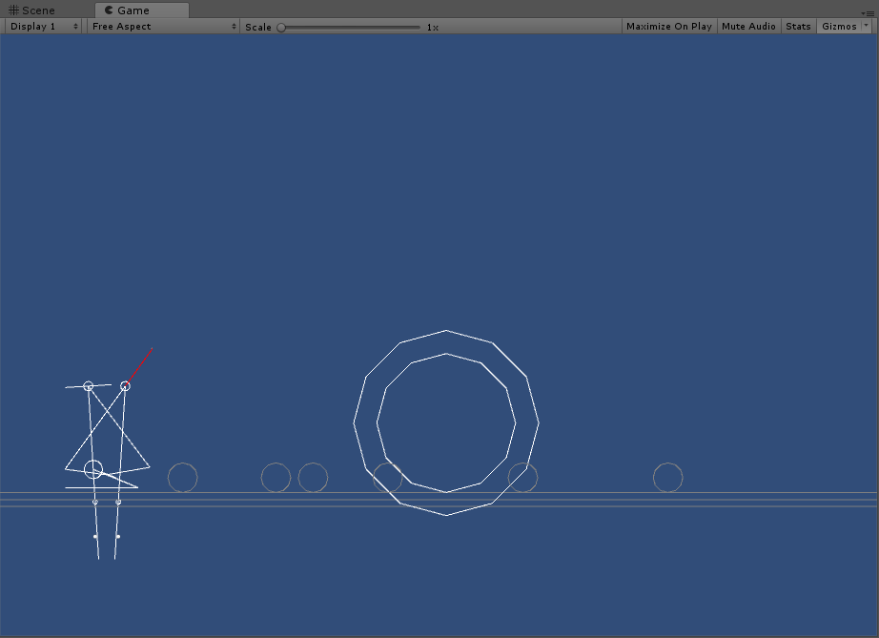
2013: Get on Top (Bennett Foddy)
6/25/15: development begins on “Sword Puppet”
Notes:
What it is

Slide 5
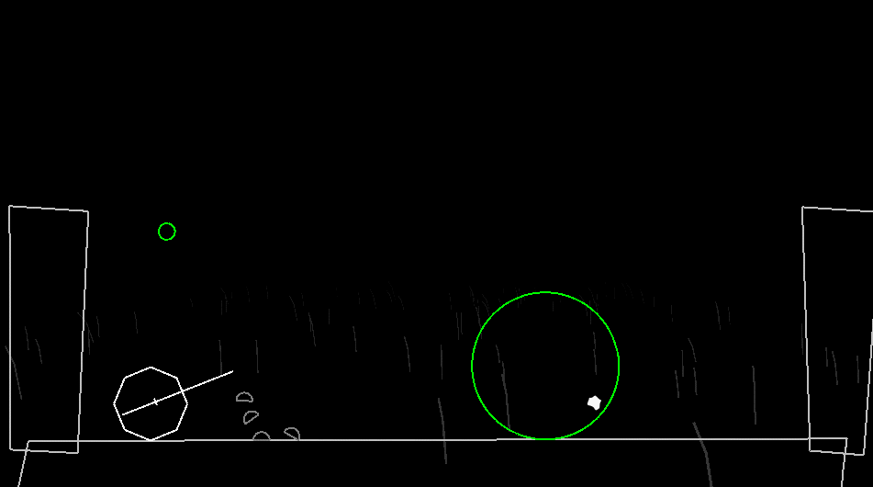
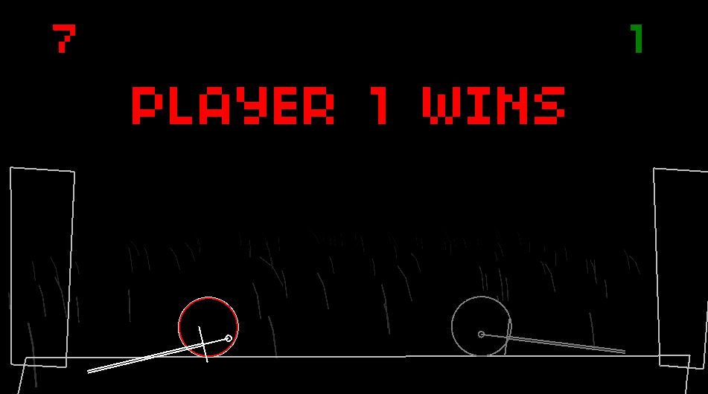
7/6/15:
switched from Unity to Flint (Final Form Games engine)
added slicing
7/9/15:
added pvp
added Warrior (Kesha track)
demoed at dev night

Slide 6
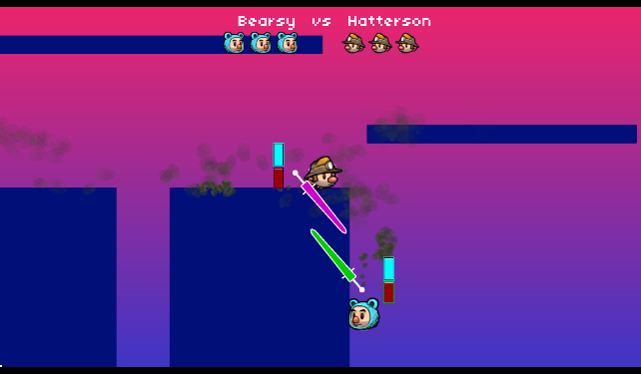
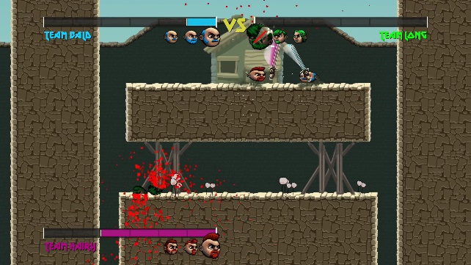
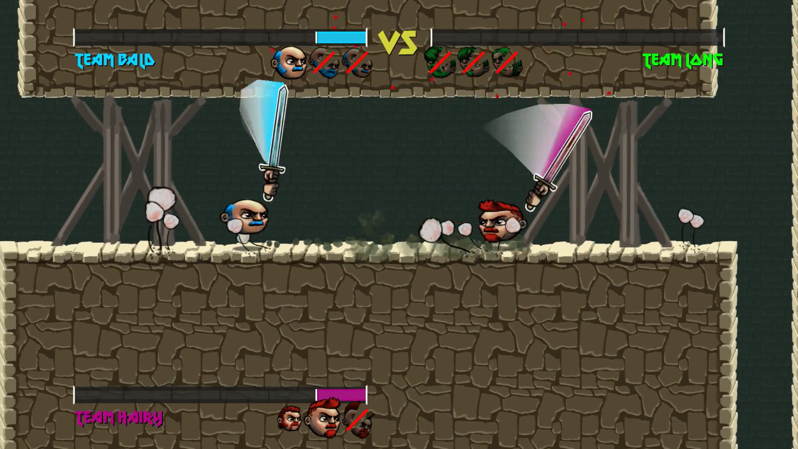
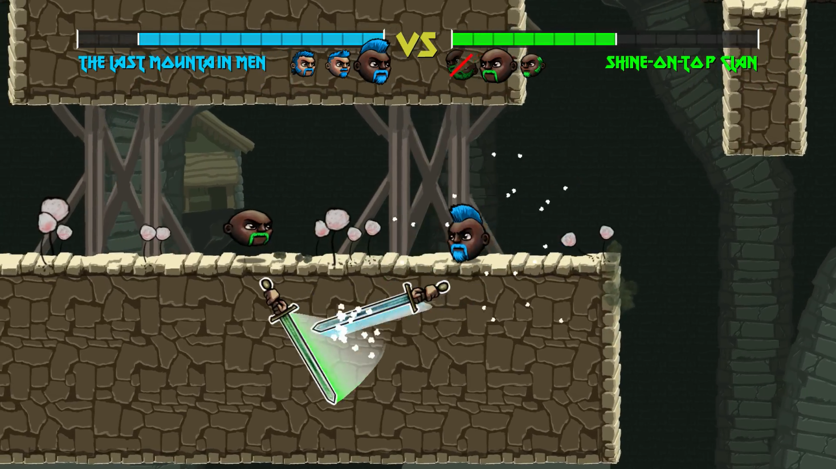
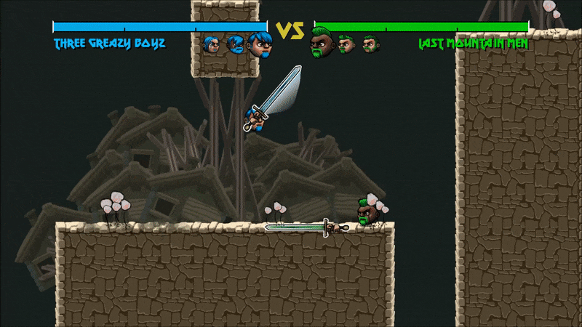
August 2015: showed privately at PAX
October 2015: feature complete
(September 2015 – June 2017: College)
November 2017: released
Notes:
What goes into making a small game like this

Slide 7
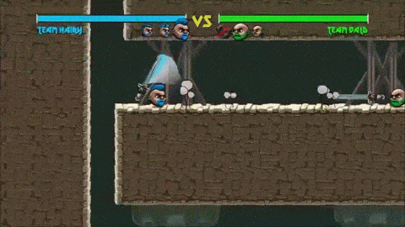
Mostly developed summer 2015

Slide 8
Released November 2017

Slide 9
Choice of Engine

Slide 10
the vision: “physics-based sword fighting”

Slide 11
Swords must always…
collide with each other
seem to have weight
But also…
follow the analog stick
respond immediately to input
Notes:
A, B: box2d (standard physics engine, built into unity)

Slide 12
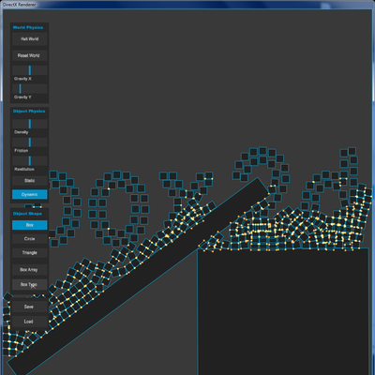
Sword Collisions

Slide 13
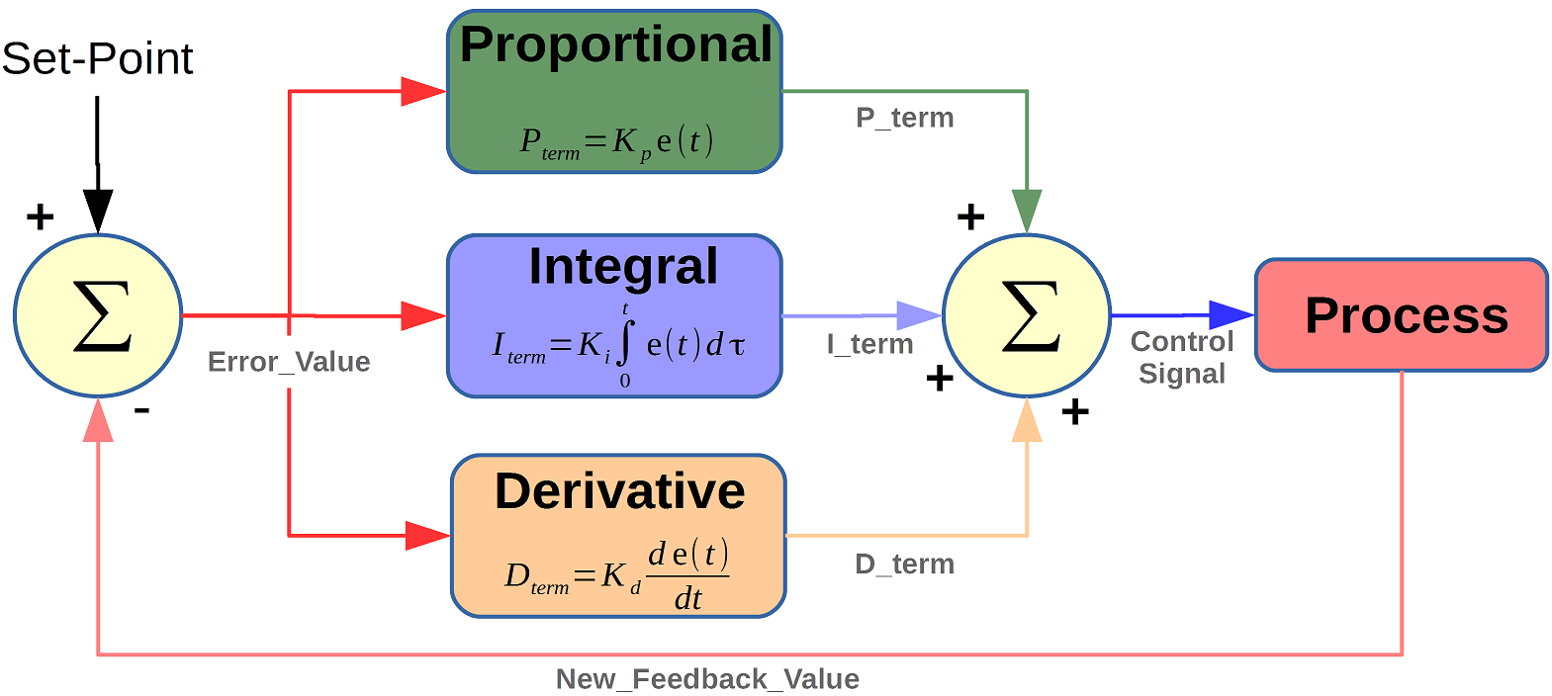
Sword controls: PID controller
https://www.mathworks.com/matlabcentral/mlc-downloads/downloads/submissions/58257/versions/1/screenshot.png
Notes:
https://www.mathworks.com/matlabcentral/mlc-downloads/downloads/submissions/58257/versions/1/screenshot.png

Slide 14
PID controller
force =
p*(signed distance)
+ d*(relative velocity)
+ i*(integral of signed distance)
spring
damping
extra correction

Slide 15
Swords must always…
collide with each other
seem to have weight
But also…
follow the analog stick
Respond immediately to input
Notes:
A, B: box2d (standard physics engine, built into unity)

Slide 16
Swords must always…
A. collide with each other
But also…
C. follow the analog stick
Swords must always…
B. seem to have weight
But also…
D. respond immediately to input
Sword center of mass in the hilt
Inelastic collisions
Hands respond faster than blade

Slide 17
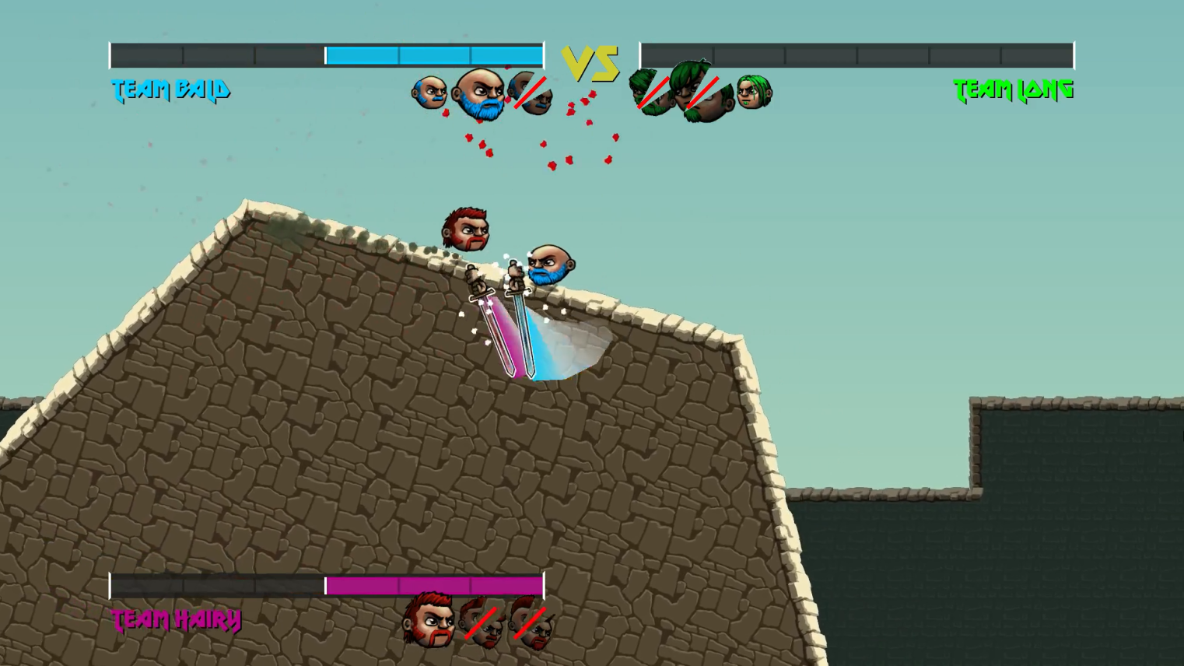
Sword center of mass in the hilt

Slide 18
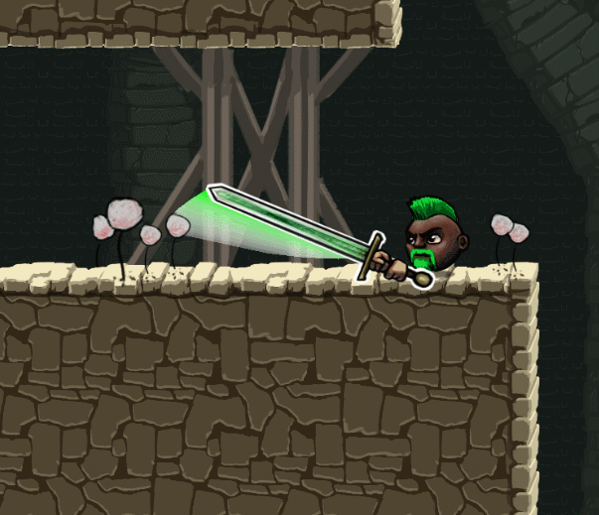
Hands respond faster than blade

Slide 19
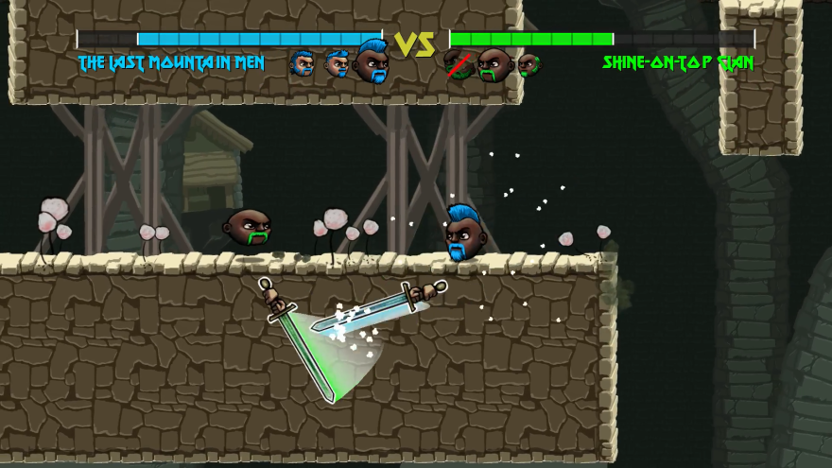
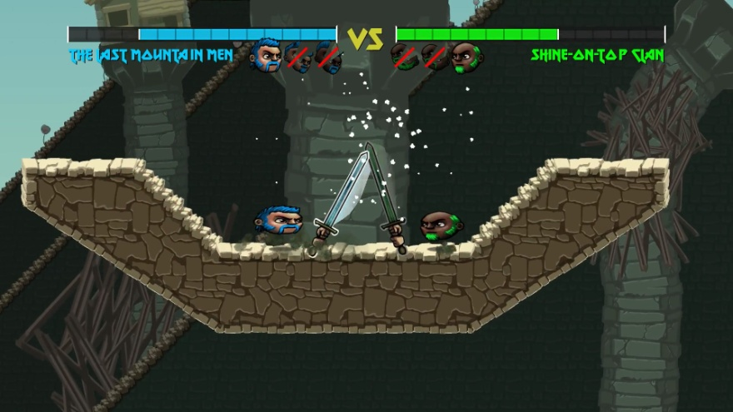
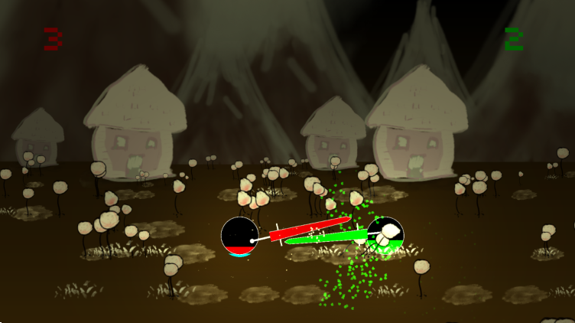
Fantasy sword physics
Good: sword hits
Also good: sword locks
BAD: weak sword bounces
Notes:
Swords are up to 10x heavier:
during long swings
when swinging fast
when player is moving fast
when far away from the joystick direction (“pushing harder”)
Swords accelerate faster:
when reversing direction
when very close to player (less than default distance)
when far away from the joystick direction

Slide 20
Fantasy sword physics
A sword becomes 5x-10x heavier:
during long swings
when swinging fast
when player is moving fast
when far away from the joystick direction (“pushing harder”)
Notes:
Swords are up to 10x heavier:
during long swings
when swinging fast
when player is moving fast
when far away from the joystick direction (“pushing harder”)
Swords accelerate faster:
when reversing direction
when very close to player (less than default distance)
when far away from the joystick direction

Slide 21
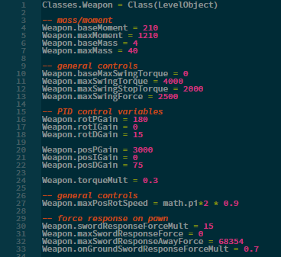
Fantasy sword physics
Notes:
Swords are up to 10x heavier:
during long swings
when swinging fast
when player is moving fast
when far away from the joystick direction (“pushing harder”)
Swords accelerate faster:
when reversing direction
when very close to player (less than default distance)
when far away from the joystick direction

Slide 22
Sword controls work… what now? Yomi, RPS, and Fighting Games

Slide 23
Yomi
“Yomi” is the Japanese word for “reading,” as in reading the mind of the opponent.
If you have a powerful move and use it against an unskilled opponent, I call that Yomi Layer 0, meaning neither player is even bothering with trying to know what the opponent will do.
At Layer 1, your opponent does the counter to your move because they expect it.
At Layer 2, you do the counter to their counter.
- David Sirlin, Balancing Multiplayer Games

Slide 24
Sword Fighting
Retreat +
Attack
Arrow: “is countered by”
Double arrow:
high ground advantage
Direct attack
Indirect/dodging attack
Parry+riposte

Slide 25
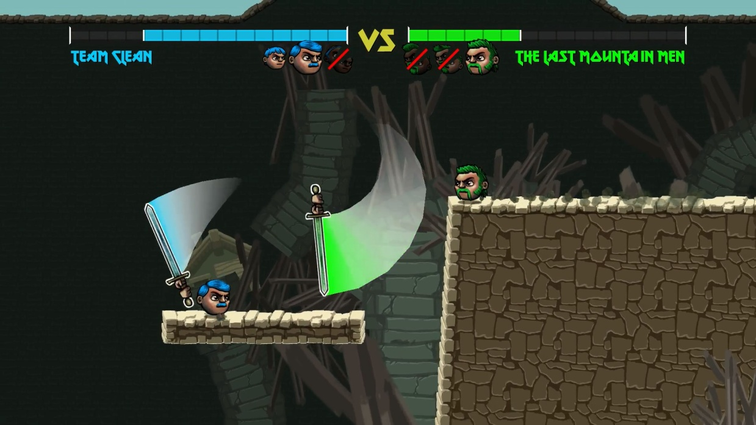
Yomi 0
Direct attack

Slide 26
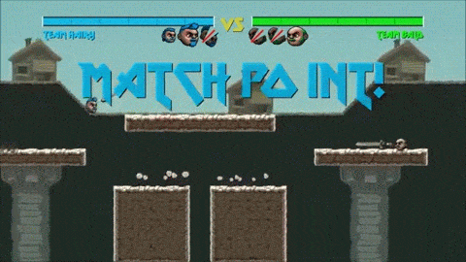
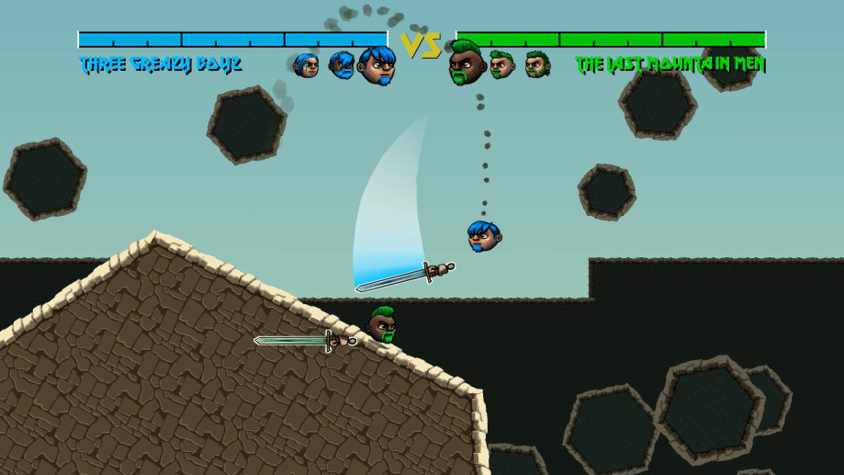
Yomi 1
Arrow: “is countered by”
Direct attack
Indirect/dodging attack

Slide 27
Yomi 2
Arrow: “is countered by”
Retreat +
Attack
Direct attack
Indirect/dodging attack

Slide 28
Rock Paper Scissors
“There are noticeable patterns based on the outcome of the previous round – there is a slight tendency to keep the same move after winning, and to pick a new move after losing (win-stay/lose-shift).
My real goal is to efficiently discover what I’m up against – a complete fish who always plays rock, a standard donkey playing w-s/l-s, a medium sized shark playing (w-s/l-s)’ or a killer with the capacity of identifying my own gear-changing strategy and adapting to me.”
- Frank Lantz, Nothing Beats Rock

Slide 29
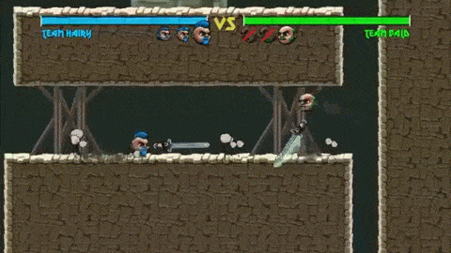
Yomi ???
Arrow: “is countered by”
Double arrow:
high ground advantage
Retreat +
Attack
Direct attack
Indirect/dodging attack
Parry+riposte
Notes:
Physics: growing possibility space, making optimal play near-impossible

Slide 30
Viable Options
“Cards are usually banned from play if they enable a deck or play style that heavily skews the play environment. What does that mean? If the card were legal, a competitive player either must be playing it, or must be specifically targeting it with his or her own strategies.”
- Magic: The Gathering Banned/Restricted List

Slide 31
I’m a way better dev now.
I should start over.
I should improve what’s important.

Slide 32
Small changes that matter

Slide 33
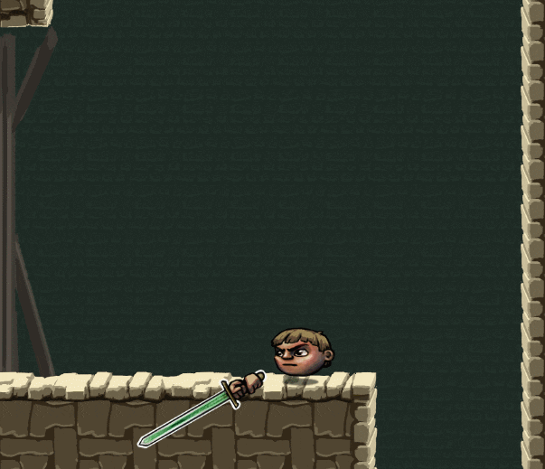
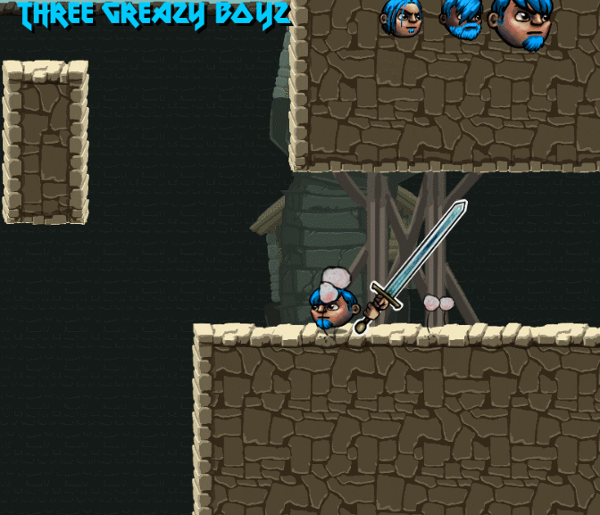
Movement polish
October 2015
November 2017

Slide 34
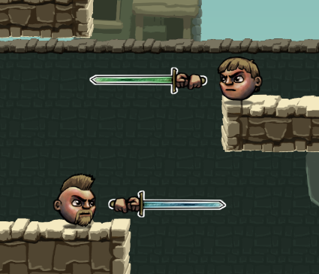
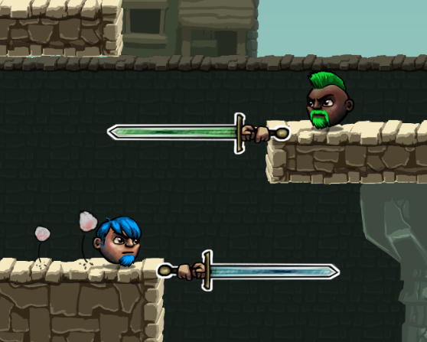
Sword below body
October 2015
November 2017

Slide 35
Doubled health totals
October 2015
November 2017

Slide 36
Big changes that failed
Sword controller rewrite -> not as good!
Single-player -> not as fun!
Also:
hats, other weapons, other modes, etc etc etc

Slide 37
Biggest changes not attempted
Level/entity/editor system from 2013
Framework code from 2014

Slide 38
Recommended Stuff
Get On Top (Sportsfriends version) - Bennett Foddy
A Tale of Two Jousts: Multimedia, Game Feel, and Imagination - Douglas Wilson
Nothing Beats Rock - Frank Lantz
Life and Death and Middle Pair - Frank Lantz
Balancing Multiplayer Games - David Sirlin
2-player games - Michael Brough
Banned and Restricted Lists - Magic: The Gathering Team

Slide 39
Super huge thanks
Mike Ambrogi Primo
Jake O’Brien, Shawn Pierre, and Philly Game Mechanics
Tim Ambrogi Saxon
Francisco Cerda
Philly Game Forge

